Slide 1
Using, misusing, and improving online machine learning-based meta-analysis of neuroimaging published data: a perspective on NeuroQuery – Supplementary Materials
Irvine Mason†, Yara Mahafza†, Andre’ Telfer†, Argel Aguilar Valles & Amedeo D’Angiulli*
† Contributed equally, shared first authorship
*Corresponding author: amedeodangiulli@cunet.carleton.ca

Slide 2
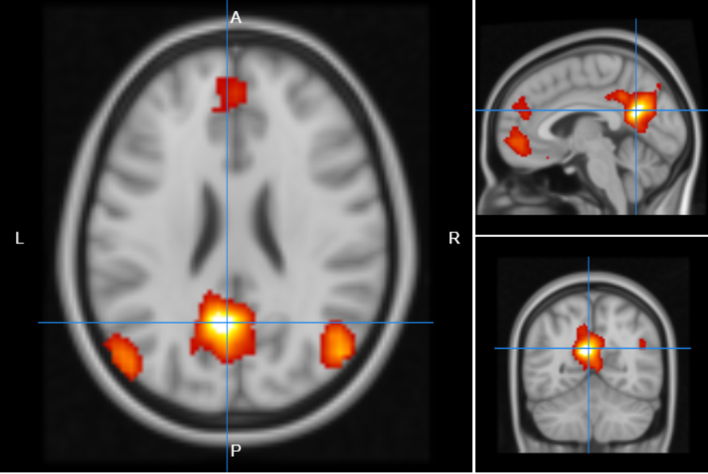
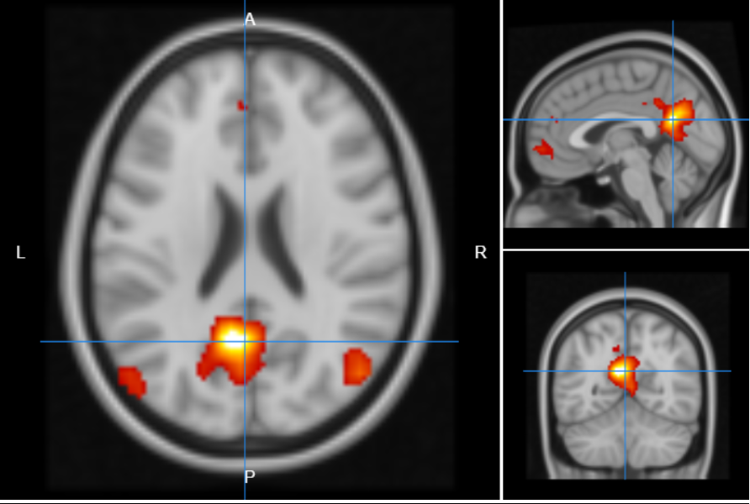
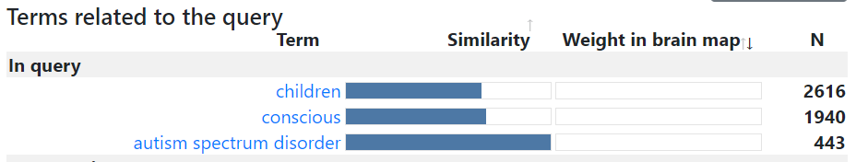
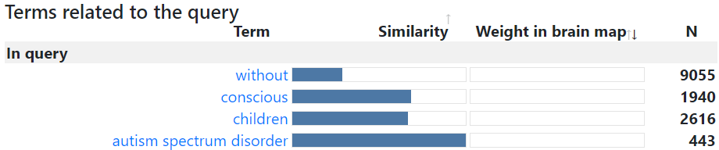
Fig. 1 Preliminary outputs of query #1: consciousness in children with (left) and without (right) autism spectrum disorder. The key terms influencing the outputs are shown at the bottom

Slide 3
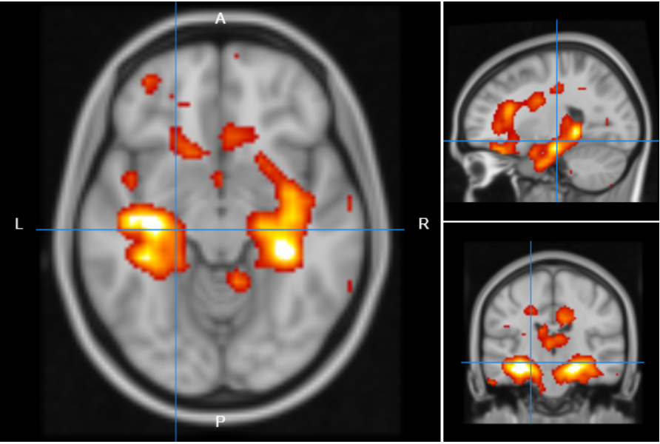
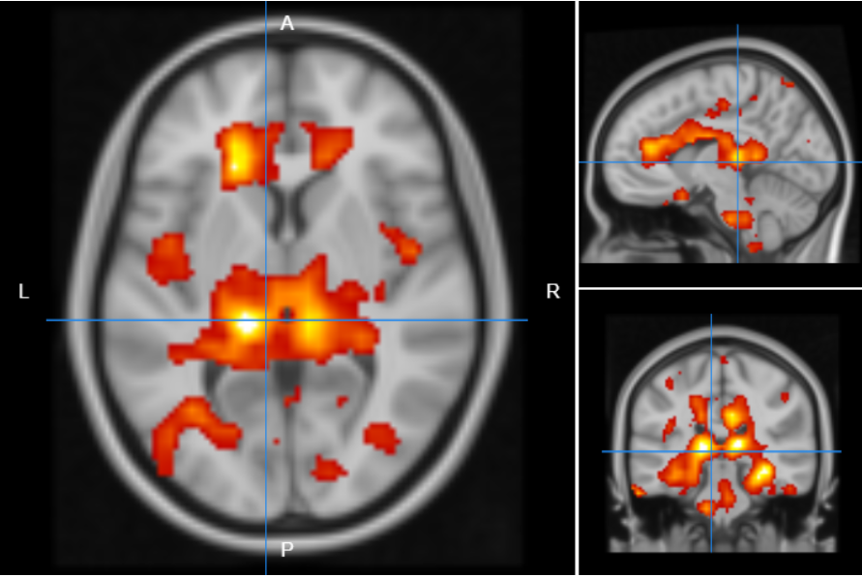
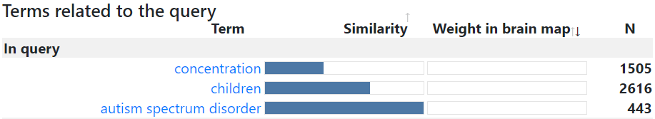
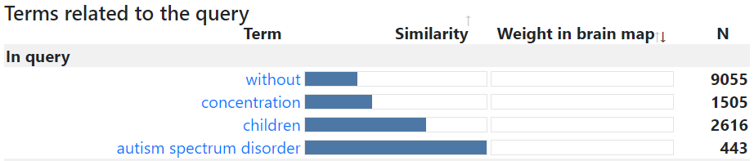
Fig. 2 Preliminary outputs of query #2: concentration in children with (left) and without (right) autism spectrum disorder. The key terms influencing the outputs are shown at the bottom

Slide 4
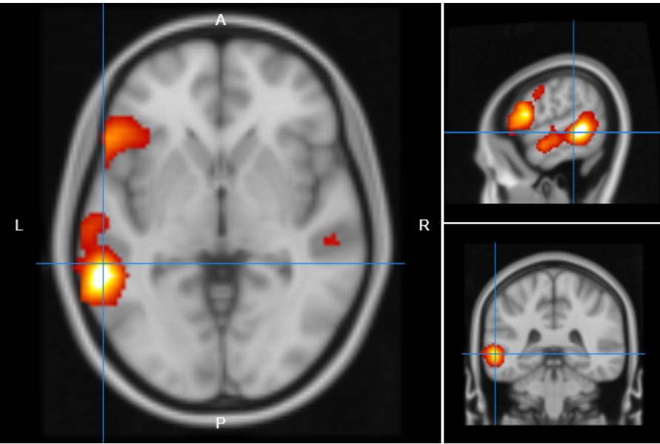
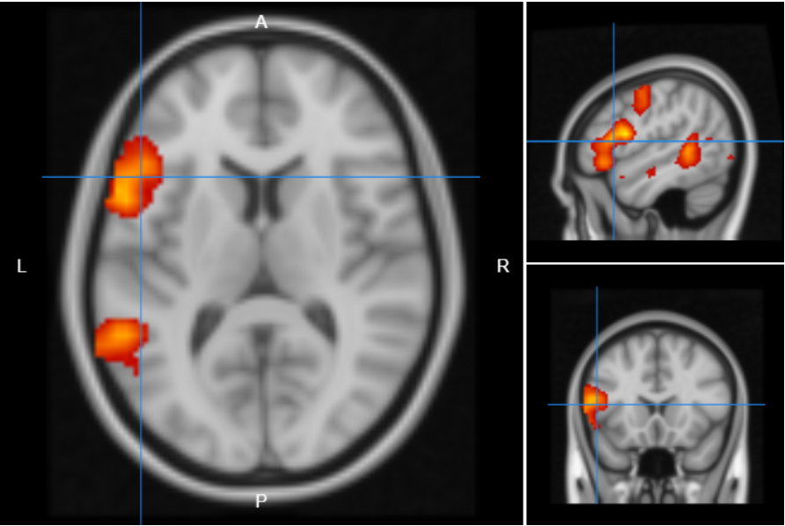
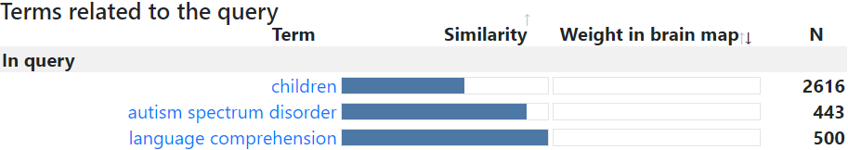
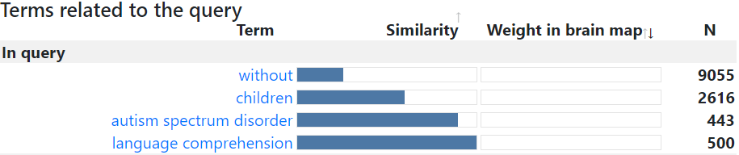
Fig. 3 Preliminary outputs of query #3: language comprehension in children with (left) and without (right) autism spectrum disorder. The key terms influencing the outputs are shown at the bottom

Slide 5
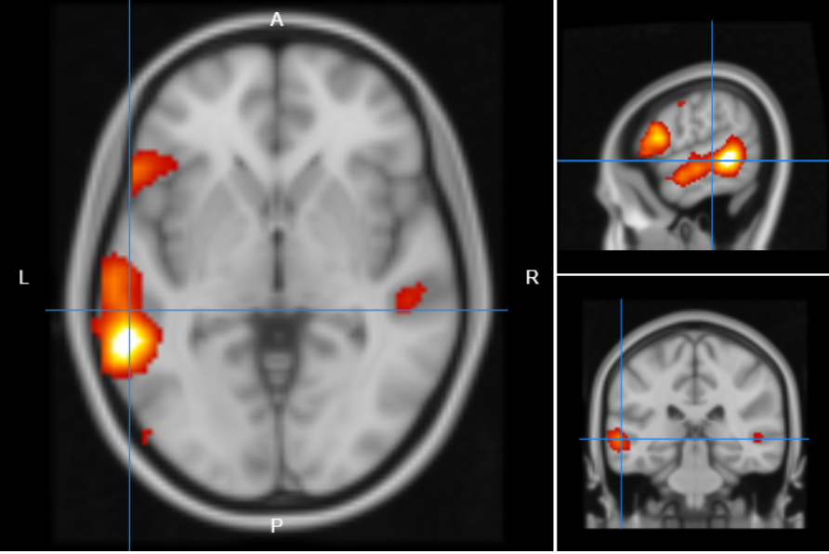
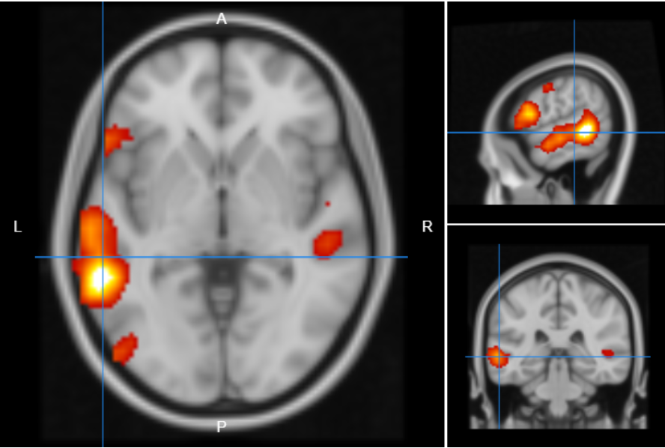
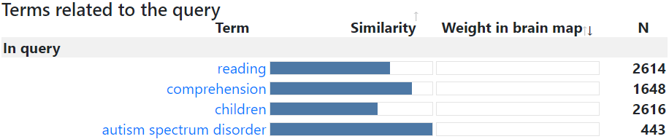
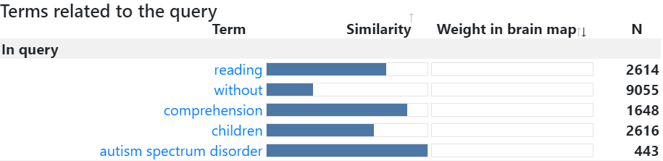
Fig. 4 Preliminary outputs of query #4: reading comprehension in children with (left) and without (right) autism spectrum disorder. The key terms influencing the outputs are shown at the bottom

Slide 6
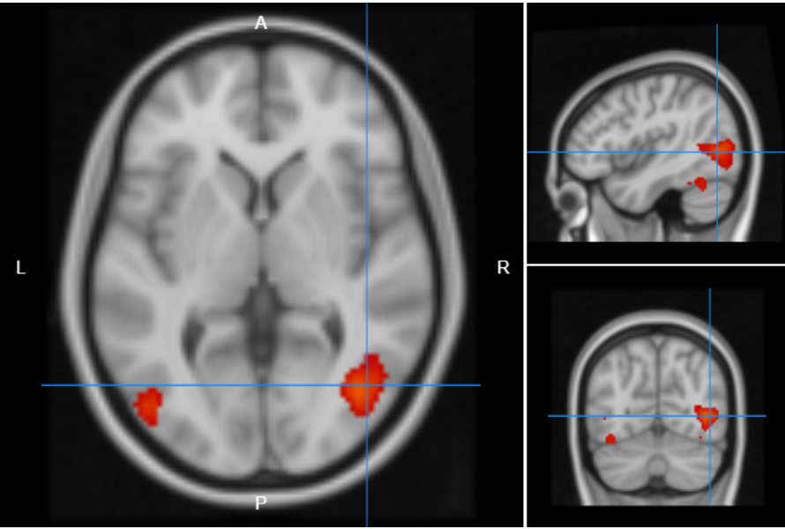
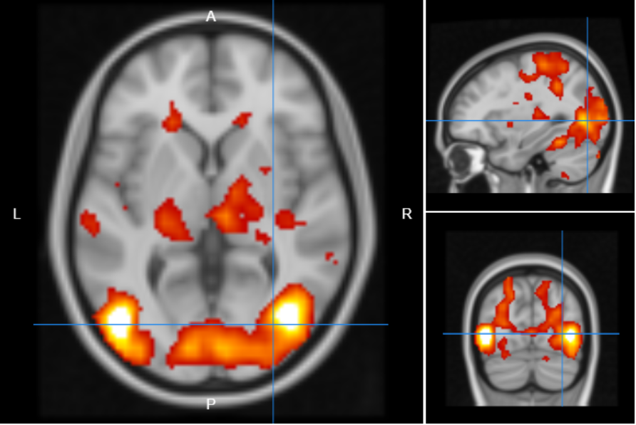
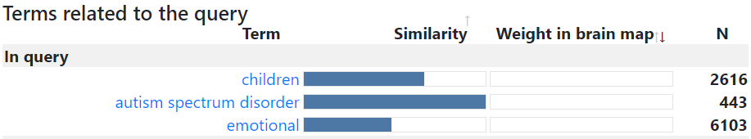
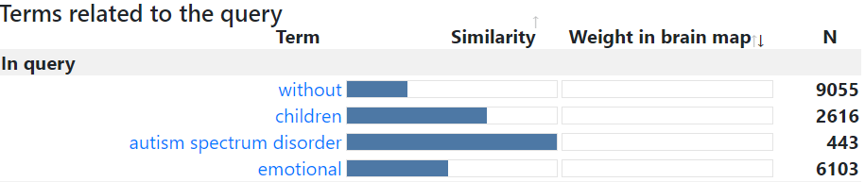
Fig. 5 Preliminary outputs of query #5: emotion in children with (left) and without (right) autism spectrum disorder. The key terms influencing the outputs are shown at the bottom

Slide 7
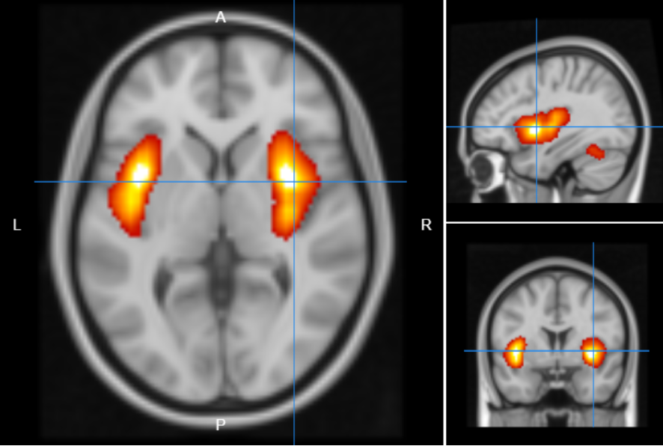
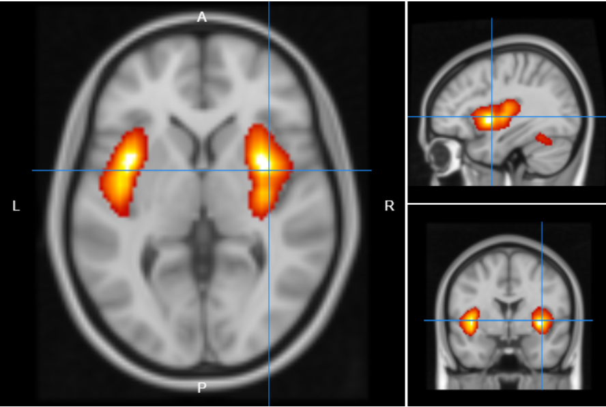
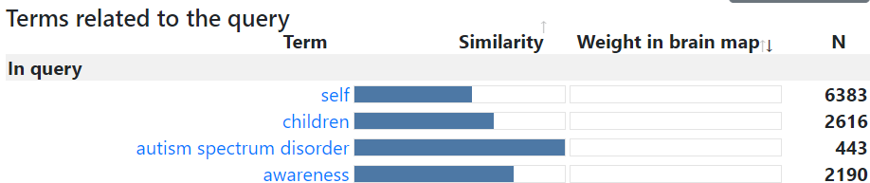
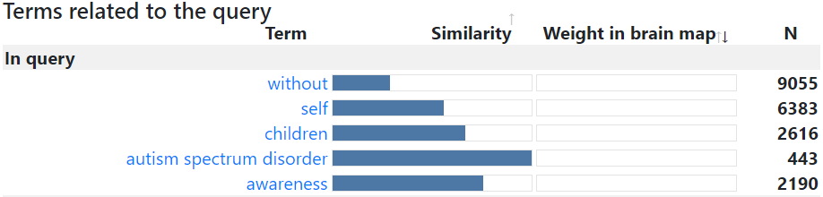
Fig. 6 Preliminary outputs of query #6: self-awareness in children with (left) and without (right) autism spectrum disorder. The key terms influencing the outputs are shown at the bottom

Slide 8
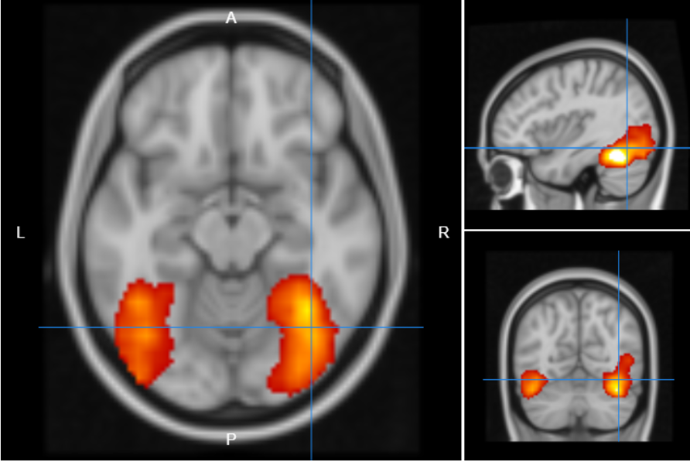
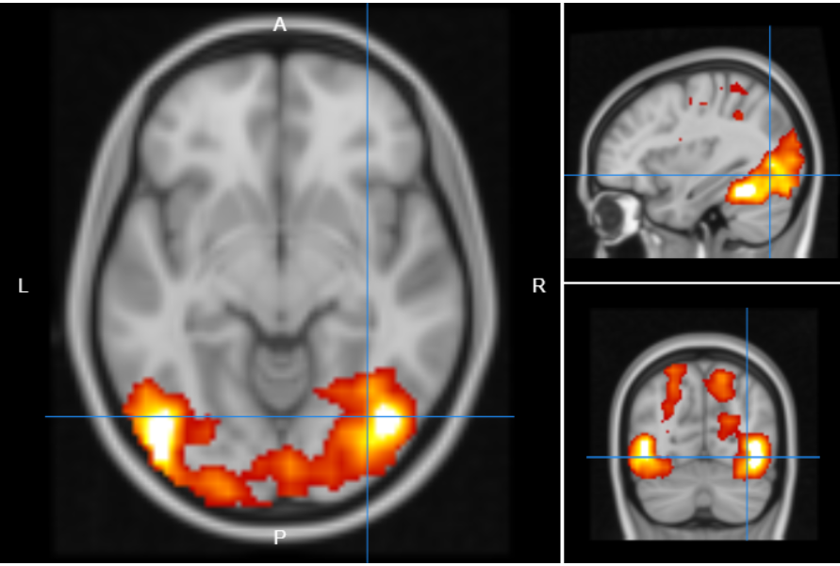
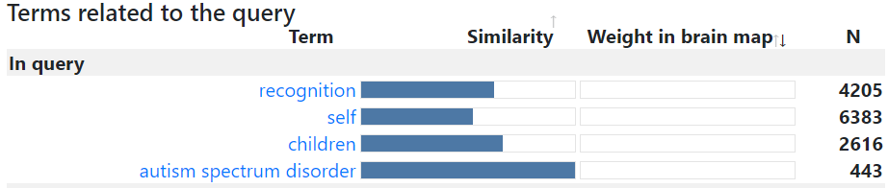
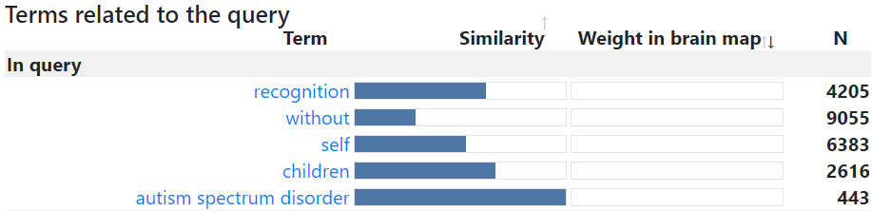
Fig. 7 Preliminary outputs of query #7: self-recognition in children with (left) and without (right) autism spectrum disorder. The key terms influencing the outputs are shown at the bottom

Slide 9
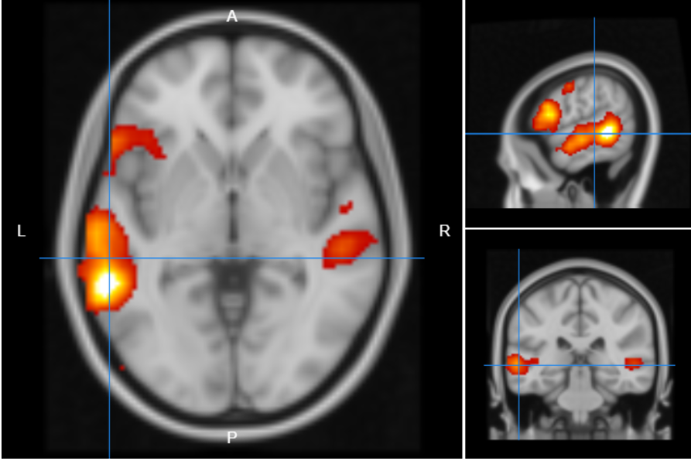
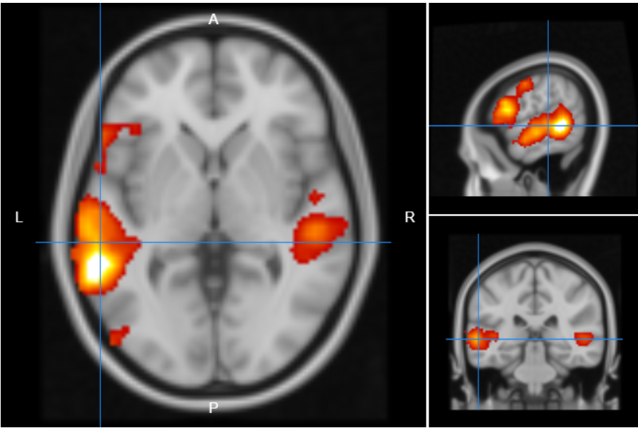
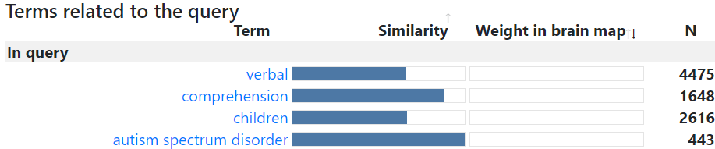
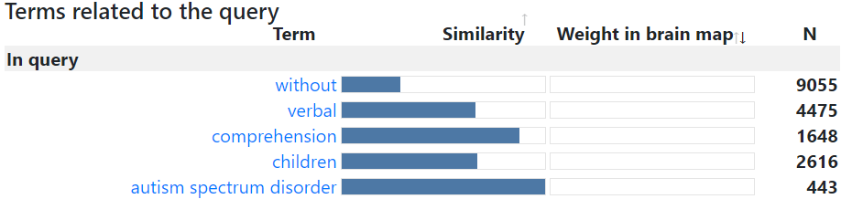
Fig. 8 Preliminary outputs of query #8: verbal comprehension in children with (left) and without (right) autism spectrum disorder. The key terms influencing the outputs are shown at the bottom

Slide 10
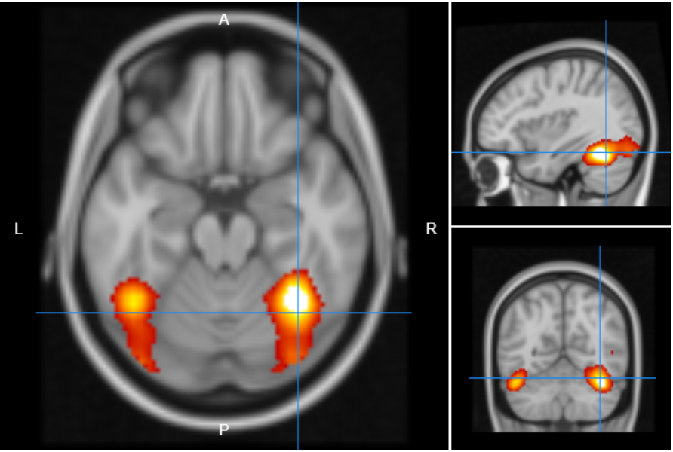
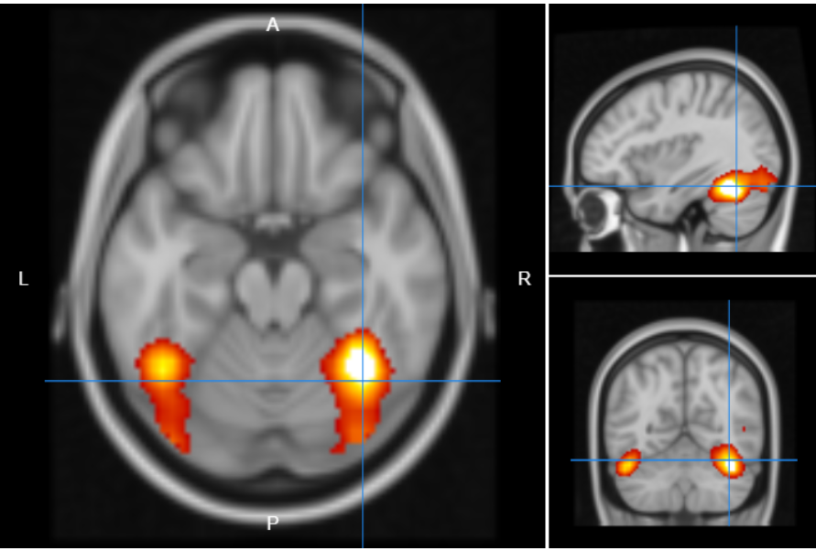
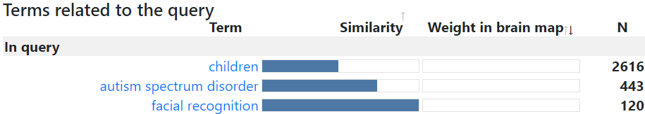
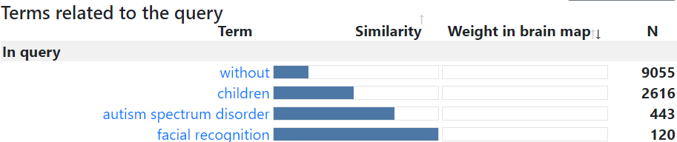
Fig. 9 Preliminary outputs of query #9: facial recognition in children with (left) and without (right) autism spectrum disorder. The key terms influencing the outputs are shown at the bottom

Slide 11
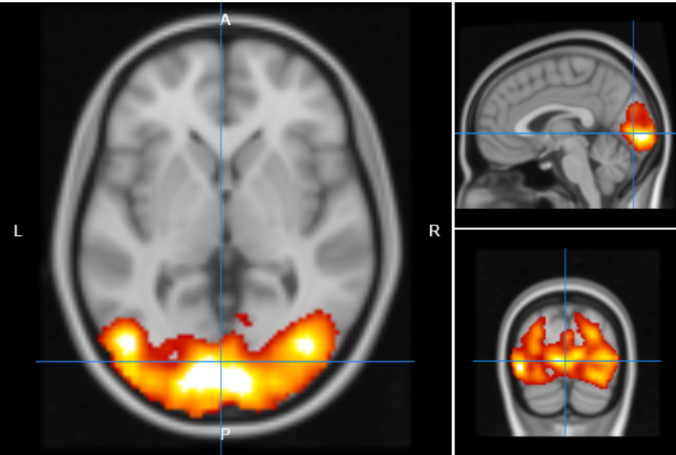
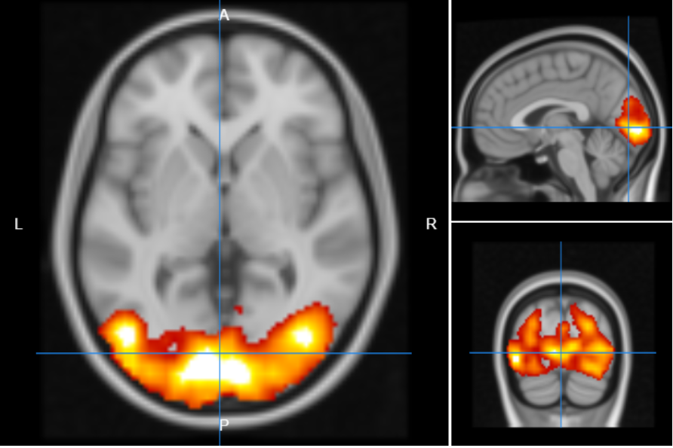
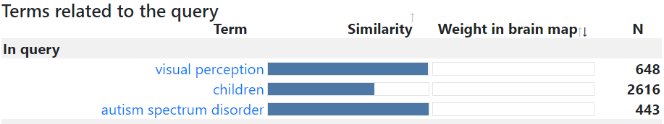
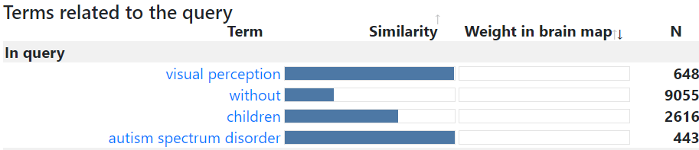
Fig. 10 Preliminary outputs of query #10: visual perception in children with (left) and without (right) autism spectrum disorder. The key terms influencing the outputs are shown at the bottom

Slide 12
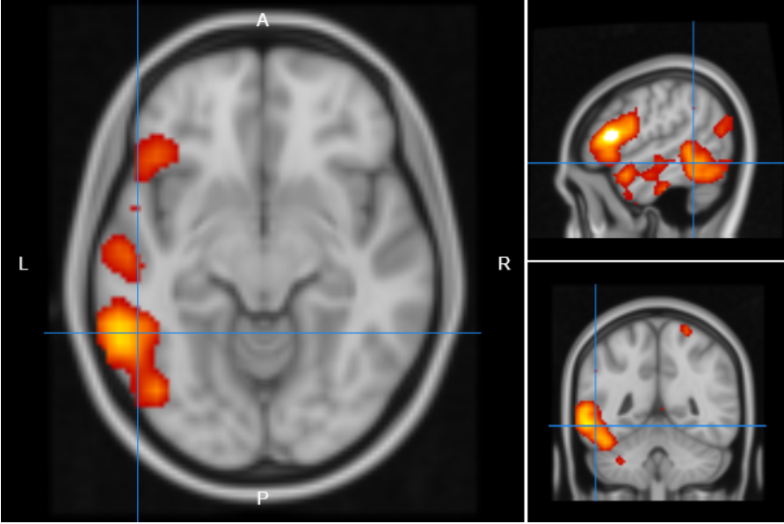
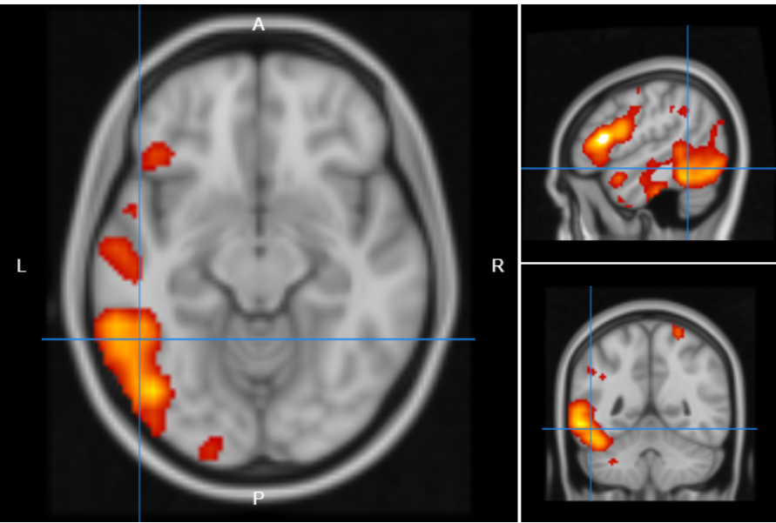
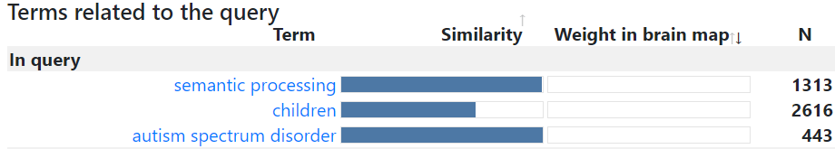
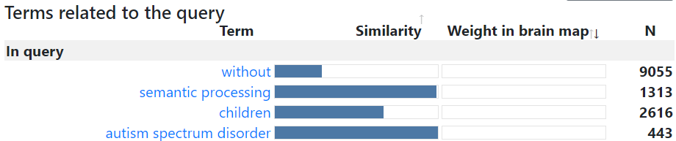
Fig. 11 Preliminary outputs of query #11: semantic processing in children with (left) and without (right) autism spectrum disorder. The key terms influencing the outputs are shown at the bottom

Slide 13
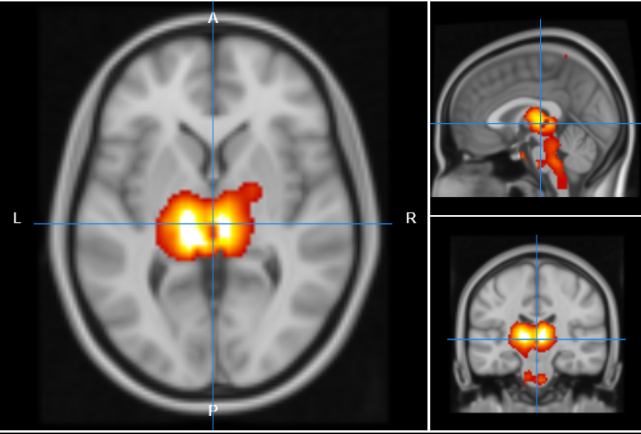
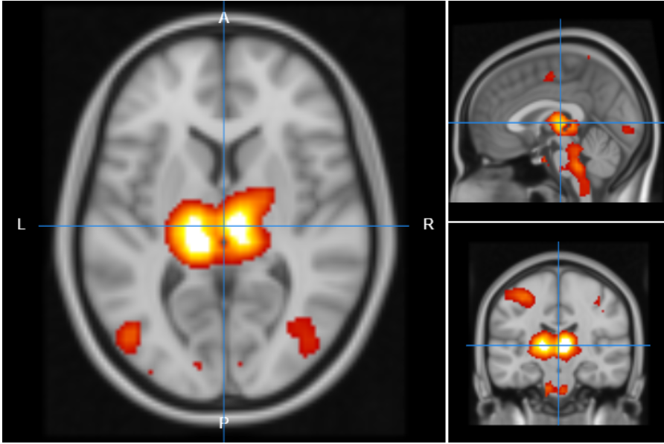
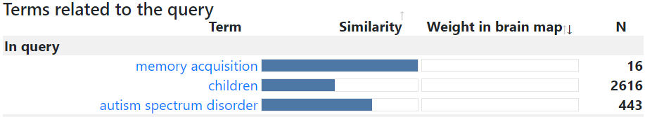
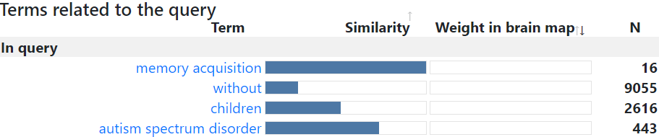
Fig. 12 Preliminary outputs of query #12: memory acquisition in children with (left) and without (right) autism spectrum disorder. The key terms influencing the outputs are shown at the bottom

Slide 14
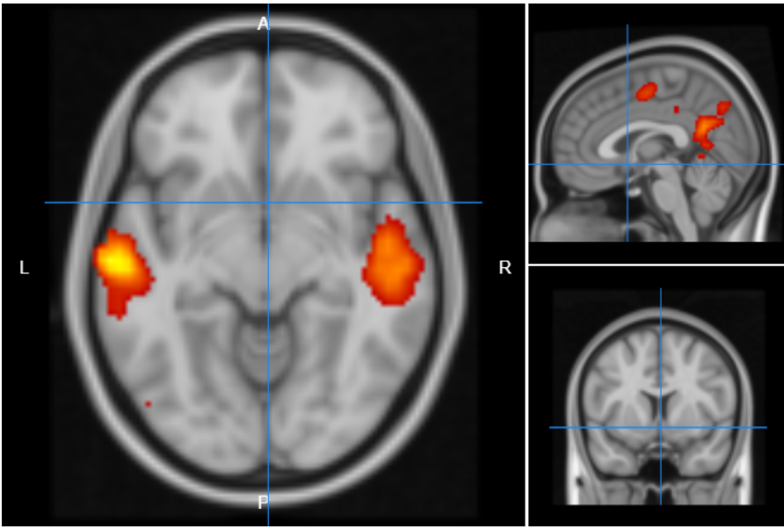
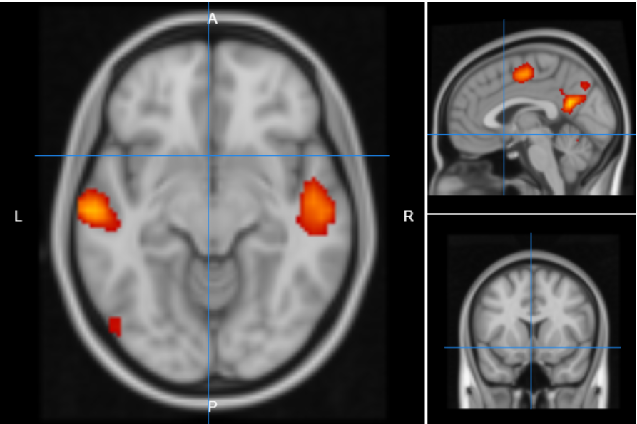


Fig. 13 Preliminary outputs of query #13: complex thought in children with (left) and without (right) autism spectrum disorder. The key terms influencing the outputs are shown at the bottom

Slide 15




Fig. 14 Preliminary outputs of query #14: procedural memory in children with (left) and without (right) autism spectrum disorder. The key terms influencing the outputs are shown at the bottom

Slide 16




Fig. 15 Preliminary outputs of query #15: sensory memory in children with (left) and without (right) autism spectrum disorder. The key terms influencing the outputs are shown at the bottom

Slide 17




Fig. 16 Preliminary outputs of query #16: short-term memory in children with (left) and without (right) autism spectrum disorder. The key terms influencing the outputs are shown at the bottom

Slide 18




Fig. 17 Preliminary outputs of query #17: theory of mind in children with (left) and without (right) autism spectrum disorder. The key terms influencing the outputs are shown at the bottom

